Slide 1
Chapter 10: OSPF Tuning and Troubleshooting
Instructor Materials
CCNA Routing and Switching
Scaling Networks v6.0
Notes:
Cisco Networking Academy Program
Scaling Networks v6.0
Chapter 10: OSPF Tuning and Troubleshooting

Slide 2
Instructor Materials – Chapter 10 Planning Guide
This PowerPoint deck is divided in two parts:
Instructor Planning Guide
Information to help you become familiar with the chapter
Teaching aids
Instructor Class Presentation
Optional slides that you can use in the classroom
Begins on slide # 12
Note: Remove the Planning Guide from this presentation before sharing with anyone.
Notes:
2

Slide 3
Chapter 10: OSPF Tuning and Troubleshooting
Scaling Networks v6.0 Planning Guide
Notes:
Cisco Networking Academy Program
Scaling Networks v6.0
Chapter 10: OSPF Tuning and Troubleshooting

Slide 4
Chapter 10: Activities
What activities are associated with this chapter?
Page # | Activity Type | Activity Name | Optional?
10.0.1.2 | Class Activity | DR and BDR Elections | Optional
10.1.1.9 | Syntax Checker | Verify the Role and Adjacencies | Recommended
10.1.1.10 | Activity | Identify OSPF Network Type Terminology | Recommended
10.1.1.11 | Activity | Select the Designated Router | Recommended
10.1.1.12 | Packet Tracer | Determining the DR and BDR | Optional
10.1.1.13 | Lab | Configuring OSPFv2 on a Multiaccess Network | Optional
10.1.2.2 | Syntax Checker | Verifying a Propagated Default Route on R1 and R3 | Recommended
10.1.2.4 | Syntax Checker | Verifying a IPv6 Default Route on R1 | Recommended
10.1.2.5 | Packet Tracer | Propagating a Default Route in OSPFv2 | Recommended
10.1.3.4 | Packet Tracer | Configuring OSPF Advance Features | Optional
The password used in the Packet Tracer activities in this chapter is: PT_ccna5
Notes:
4

Slide 5
Chapter 10: Activities (Cont.)
What activities are associated with this chapter?
Page # | Activity Type | Activity Name | Optional?
10.1.3.5 | Lab | Configuring OSPFv2 Advance Features | Recommended
10.2.1.5 | Activity | Identify the Troubleshooting Command | Recommended
10.2.2.3 | Packet Tracer | Troubleshooting Single-Area OSPFv2 | Recommended
10.2.3.3 | Lab | Troubleshooting Basic Single-Area OSPFv2 and OSPFv3 | Recommended
10.2.3.4 | Lab | Troubleshooting Advanced Single-Area OSPFv2 | Optional
10.2.4.3 | Packet Tracer | Troubleshooting Multiarea OSPFv2 | Recommended
10.2.4.4 | Packet Tracer | Troubleshooting Multiarea OSPFv3 | Recommended
10.2.4.5 | Lab | Troubleshooting Multiarea OSPFv2 and OSPFv3 | Optional
10.3.1.1 | Class Activity | OSPF Troubleshooting Mastery | Optional
10.3.1.2 | Packet Tracer | Skills Integration Challenge | Recommended
The password used in the Packet Tracer activities in this chapter is: PT_ccna5
Notes:
5

Slide 6
Chapter 10: Assessment
Students should complete Chapter 10, “Assessment” after completing Chapter 10.
Quizzes, labs, Packet Tracers and other activities can be used to informally assess student progress.
Notes:
6

Slide 7
Chapter 10: Best Practices
Prior to teaching Chapter 10, the instructor should:
Complete Chapter 10, “Assessment.”
Ensure this chapter becomes as hands-on as possible.
Set the stage. In the classification of dynamic routing protocols, where does OSPF fit? (Compare and contrast OSPF to EIGRP.)
Reinforce the fact that OSPF routers form adjacencies using Hello packets. Adjacencies are only formed when the following match:
Network type
Area ID
Hello and Dead timers
Show examples of different network types.
Demonstrate the output of the show ip ospf neighbor command with a Packet Tracer OSPF network. (Show neighbor adjacencies and their state: Full/DR or Full/DROTHER.)
Notes:
7

Slide 8
Chapter 10: Best Practices (Cont.)
Describe problems that could occur in OSPF networks without a DR by using the following formula:
n(n–1)/2 (n=number of routers)
For example: Eight routers would have 8(7)/2 = 56/2 = 28 adjacencies
This is very inefficient; thus, the election of the DR and BDR reduces all update traffic on the network.
Demonstrate the election process on an OSPF network by having the network configured with an active DR. Use the debug ip ospf events command and disconnect the DR and watch the election take place.
Demonstrate the lab several times by changing router IDs, priorities, and loopbacks so that students can see the rule for election in action.
The router with the highest interface priority is elected as the DR; the router with the second highest interface priority is elected as the BDR.
The priority can be configured between 0–255.
Priority of 0 – router cannot become the DR.
Notes:
8

Slide 9
Chapter 10: Best Practices (Cont.)
Explain that if interface priorities are equal, then the router with the highest router ID is elected DR and the second highest is the BDR.
Identify the three ways to determine the router ID:
The router ID can be manually configured.
If not configured, the ID is determined by highest loopback IP address.
If no loopbacks, the ID is determined by the highest active IPv4 address.
Emphasize that in an IPv6 network, the router ID must be manually configured.
Explain that propagating a route in OSPF, the same command is used in OSPFv2 and v3.
Router(config)# router ospf 4
Router(config-router)# default-information originate
Explain that, unlike EIGRP, OSPF Hello and Dead intervals must match or a neighbor adjacency will not occur.
Notes:
9

Slide 10
Chapter 10: Best Practices (Cont.)
Troubleshoot OSPF commands:
OSPFv2 OSPFv3
show ip protocols show ipv6 protocols
show ip ospf neighbor show ipv6 ospf neighbor
show ip ospf interface show ipv6 ospf interface
show ip ospf show ipv6 ospf
show ip route ospf show ipv6 route ospf
clear ip ospf [id] process clear ip ospf [id] process
Notes:
10

Slide 11
Chapter 10: Additional Help
For additional help with teaching strategies, including lesson plans, analogies for difficult concepts, and discussion topics, visit the CCNA Community at: https://www.netacad.com/group/communities/community-home
Best practices from around the world for teaching CCNA Routing and Switching. https://www.netacad.com/group/communities/ccna
If you have lesson plans or resources that you would like to share, upload them to the CCNA Community in order to help other instructors.
Students can enroll in Introduction to Packet Tracer (self-paced)
Notes:
11

Slide 13
Chapter 10: OSPF Tuning and Troubleshooting
CCNA Routing and Switching
Scaling Networks v6.0
Notes:
Cisco Networking Academy Program
Scaling Networks v6.0
Chapter 10: OSPF Tuning and Troubleshooting

Slide 14
Chapter 10 - Sections & Objectives
10.1 Advanced Single-Area OSPF Configurations
Configure the OSPF interface priority to influence the DR/BDR election.
Configure OSPF to propagate a default route.
Configure OSPF interface settings to improve network performance.
10.2 Troubleshooting Single-Area OSPF Implementations
Explain the process and tools used to troubleshoot a single-area OSPF network.
Troubleshoot missing route entries in the single-area OSPFv2 routing table.
Troubleshoot missing route entries in a single-area OSPFv3 routing table.
Troubleshoot missing route entries in multiarea OSPFv2 and OSPFv3 routing tables.
Notes:
14
Cisco Networking Academy Program
Scaling Networks v6.0
Chapter 10: OSPF Tuning and Troubleshooting

Slide 15
10.1 Advanced Single-Area OSPF Configurations
Notes:
10 – OSPF Tuning and Troubleshooting
10.1 – Advanced Single-Area OSPF Configurations

Slide 16
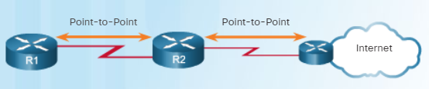
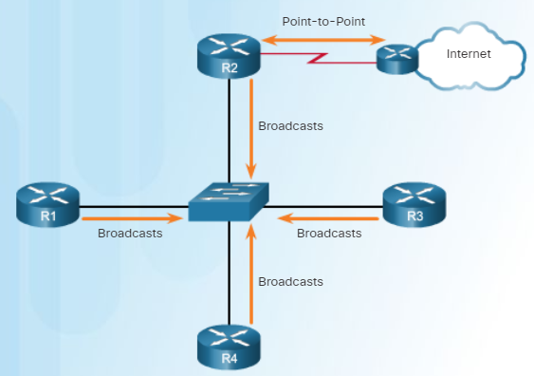
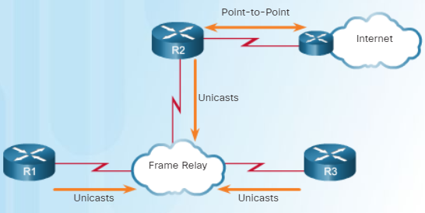
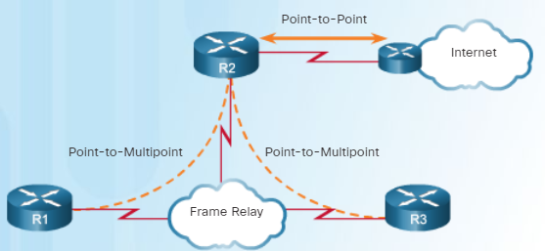
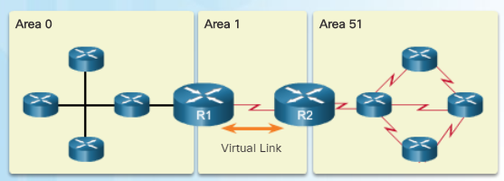
Advanced Single-Area OSPF Configurations OSPF Network Types
Point-to-point | Broadcast multiaccess | Nonbroadcast multiaccess (NBMA) | Point-to-multipoint | Virtual links
Two routers interconnected over a common link. No other routers are on the link. Common configuration in WAN links. | Multiple routers interconnected over an Ethernet network. Ethernet LANs are the most common example of broadcast multiaccess networks. | Multiple routers interconnected in a network that does not allow broadcasts. The Frame Relay WAN protocol is an example NBMA network. | Multiple routers interconnected in a hub-and-spoke topology over an NBMA network. Often used to connect branch sites (spokes) to a central site (hub). | Special OSPF network used to interconnect distant OSPF areas to the backbone area.
Notes:
10.1 - Advanced Single-Area OSPF Configurations
10.1.1 - OSPF in Multiaccess Networks
10.1.1.1 – OSPF Network Types

Slide 17
Advanced Single-Area OSPF Configurations Challenges in Multiaccess Networks
Multiaccess networks create two challenges regarding the flooding of OSPF LSAs.
OSPF Challenges | Description
Creation of multiple adjacencies | Ethernet networks could potentially interconnect many OSPF routers creating numerous adjacencies with every router. Use the n (n-1) / 2 formula to calculate the number of adjacencies required for any number of routers (i.e., n) on a multiaccess network.
Extensive flooding of LSAs | Link-state routers flood their link-state packets when OSPF is initialized, or when there is a change in the topology. This flooding can become excessive.
Routers n | Adjacencies n (n-1)/2
4 | 6
5 | 10
10 | 45
20 | 190
50 | 1225
Notes:
10.1 - Advanced Single-Area OSPF Configurations
10.1.1 - OSPF in Multiaccess Networks
10.1.1.2 – Challenges in Multiaccess Networks

Slide 18
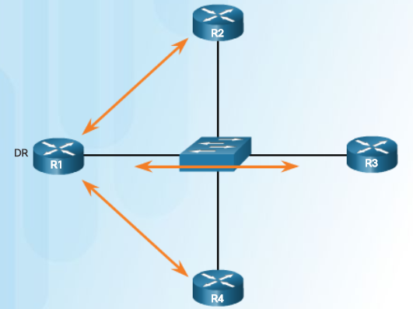
Advanced Single-Area OSPF Configurations OSPF Designated Router
On multiaccess networks, OSPF elects a DR to be the collection and distribution point for LSAs sent and received.
A BDR is also elected in case the DR fails. If the DR stops producing Hello packets, the BDR promotes itself and assumes the role of DR.
All other non-DR or BDR routers become DROTHER (a router that is neither the DR nor the BDR) and DROTHERs only form full adjacencies with the DR and BDR in the network.
Instead of flooding LSAs to all routers in the network, DROTHERs only send their LSAs to the DR and BDR using the multicast address 224.0.0.6 (all DR routers).
Notes:
10.1 - Advanced Single-Area OSPF Configurations
10.1.1 - OSPF in Multiaccess Networks
10.1.1.3 – OSPF Designated Router

Slide 19
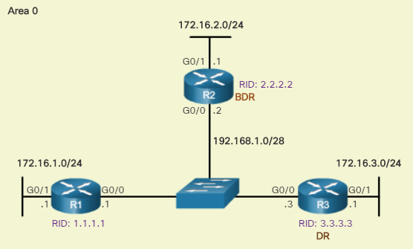
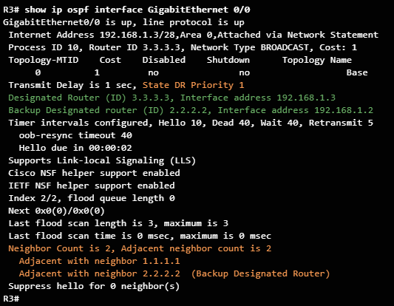
Advanced Single-Area OSPF Configurations Verifying DR/BDR Roles
OSPF has automatically elected a DR and BDR.
R3 is the DR because of its higher router ID.
R2 is the BDR because of its 2nd highest router ID.
R1 is a DROTHER.
Verify the roles of the OSPFv2 router using the show ip ospf interface command.
Note: For the equivalent OSPFv3 command, simply substitute ip with ipv6.
Notes:
10.1 - Advanced Single-Area OSPF Configurations
10.1.1 - OSPF in Multiaccess Networks
10.1.1.4 – Verifying DR/BDR Roles

Slide 20
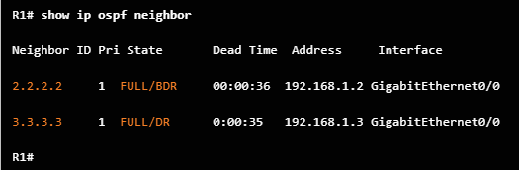
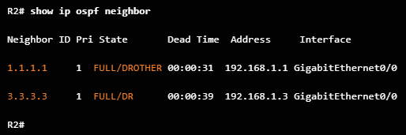
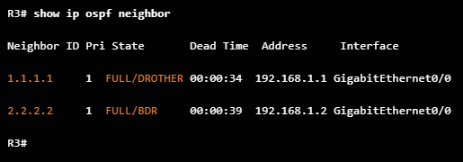
Advanced Single-Area OSPF Configurations Verifying DR/BDR Adjacencies
Verify OSPFv2 adjacencies using show ip ospf neighbor.
Routers can be in the following states:
FULL/DROTHER
FULL/DR
FULL/BDR
2-WAY/DROTHER
Note: For the equivalent OSPFv3 command, simply substitute ip with ipv6.
Notes:
10.1 - Advanced Single-Area OSPF Configurations
10.1.1 - OSPF in Multiaccess Networks
10.1.1.5 – Verifying DR/BDR Adjacencies

Slide 21
Advanced Single-Area OSPF Configurations Default DR/BDR Election Process
The OSPF DR and BDR election decision is based on the following criteria, in sequential order:
The routers in the network elect the router with the highest interface priority as the DR.
The router with the second highest interface priority is elected as the BDR.
The priority can be configured to be any number between 0 – 255 but the default priority is 1.
If the interface priorities are equal, then the router with the highest router ID is elected the DR.
The router with the second highest router ID is the BDR.
Recall that the router ID is determined in one of three ways:
The router ID can be manually configured.
If no router IDs are configured, the router ID is determined by the highest loopback IPv4 address.
If no loopback interfaces are configured, the router ID is determined by the highest active IPv4 address.
Note: In an IPv6 network, if there are no IPv4 addresses configured on the router, then the router ID must be manually configured with the router-id rid router configuration command; otherwise, OSPFv3 does not start.
Notes:
10.1 - Advanced Single-Area OSPF Configurations
10.1.1 - OSPF in Multiaccess Networks
10.1.1.6 – Default DR/BDR Election Process

Slide 22
Advanced Single-Area OSPF Configurations DR/BDR Election Process
After the DR is elected, it remains the DR until one of the following events occurs:
The DR fails.
The OSPF process on the DR fails or is stopped.
The multiaccess interface on the DR fails or is shutdown.
OSPF DR and BDR elections are not pre-emptive.
If a new router with a higher priority is added to the network after the DR election, the newly added router does not take over the DR or the BDR role because those roles have already been assigned.
If the DR fails, the BDR is automatically promoted to DR even if another DROTHER with a higher priority or router ID is added to the network after the initial DR/BDR election.
After a BDR is promoted to DR, a new BDR election occurs and the DROTHER with the higher priority or router ID is elected as the new BDR.
Notes:
10.1 - Advanced Single-Area OSPF Configurations
10.1.1 - OSPF in Multiaccess Networks
10.1.1.7 – DR/BDR Election Process

Slide 23
Advanced Single-Area OSPF Configurations The OSPF Priority
To control the DR and BDR election, the priority of an interface can be configured using:
ip ospf priority value - OSPFv2 interface command
ipv6 ospf priority value - OSPFv3 interface command
The value can be:
0 - Does not become a DR or BDR.
1 – 255 - The higher the priority value, the more likely the router becomes the DR or BDR on the interface.
Notes:
10.1 - Advanced Single-Area OSPF Configurations
10.1.1 - OSPF in Multiaccess Networks
10.1.1.8 – The OSPF Priority

Slide 24
Advanced Single-Area OSPF Configurations Changing the OSPF Priority
Changing the priority value on an interface from 1 to a higher value would enable the router to become a DR or BDR router during the next election.
Priority changes do not automatically take effect because the DR and BDR are already elected.
To force an election, use one of the following methods:
Shutdown the router interfaces and then re-enable them starting with the desired DR, then the desired BDR, and then all other routers.
Reset the OSPF process using the clear ip ospf process privileged EXEC mode command on all routers.
Notes:
10.1 - Advanced Single-Area OSPF Configurations
10.1.1 - OSPF in Multiaccess Networks
10.1.1.9 – Changing the OSPF Priority

Slide 25
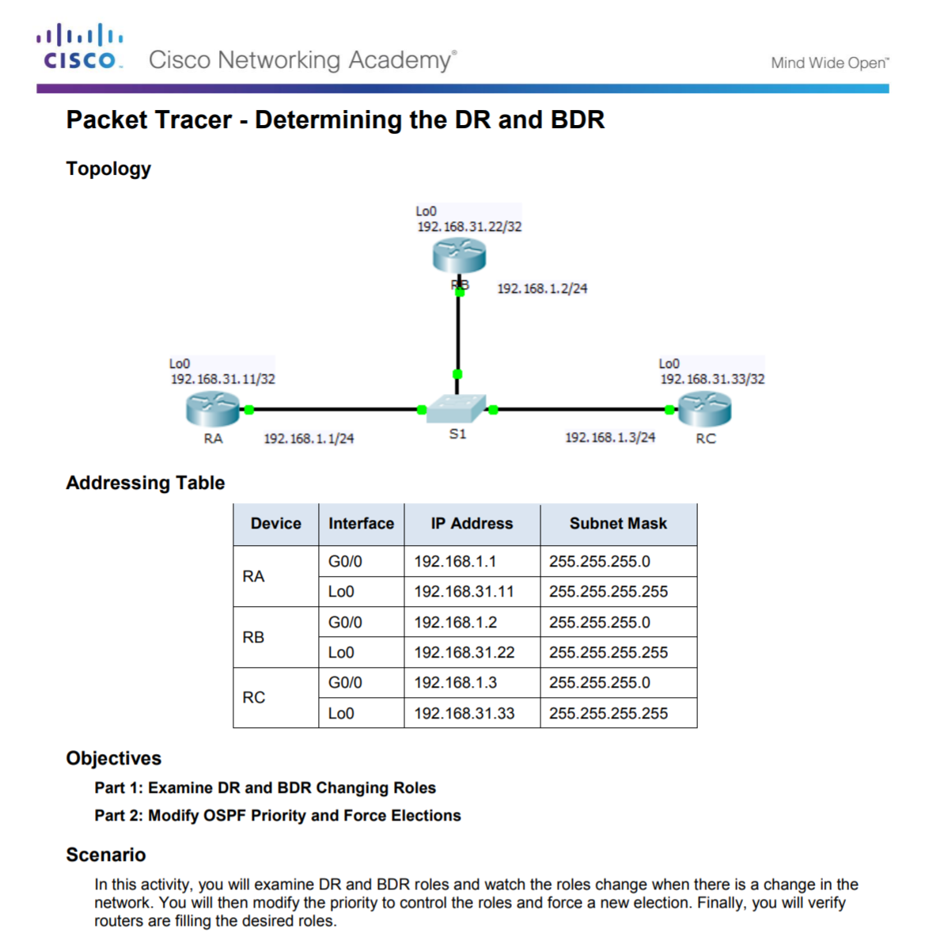
Advanced Single-Area OSPF Configurations OSPF in Multiaccess Networks
Notes:
10.1 - Advanced Single-Area OSPF Configurations
10.1.1 - OSPF in Multiaccess Networks
10.1.1.12 – Packet Tracer - Determining the DR and BDR

Slide 26
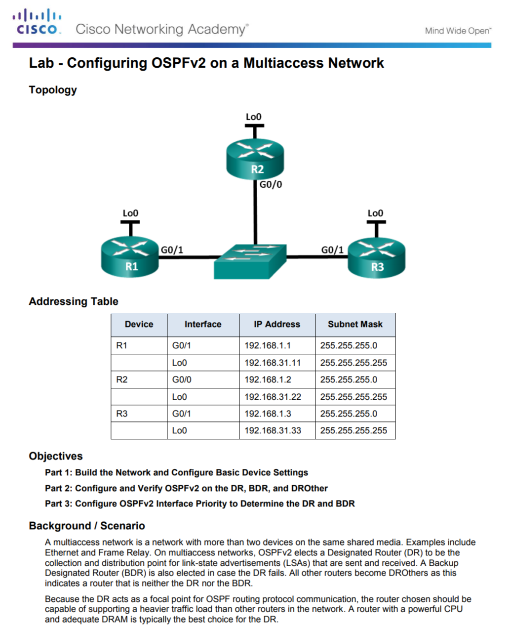
Advanced Single-Area OSPF Configurations OSPF in Multiaccess Networks
Notes:
10.1 - Advanced Single-Area OSPF Configurations
10.1.1 - OSPF in Multiaccess Networks
10.1.1.13 – Lab - Configuring OSPFv2 on a Multiaccess Network

Slide 27
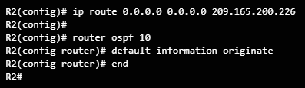
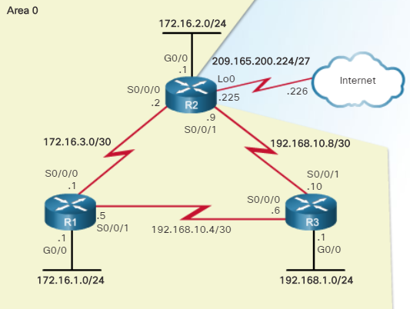
Advanced Single-Area OSPF Configurations Default Route Propagation
An OSPF ASBR router (aka, edge, entrance, or the gateway router) connects to the Internet and can be configured to propagate a default route to other routers in the OSPF routing domain.
To propagate a default route, R2 is configured with:
A default static route.
ip route 0.0.0.0 0.0.0.0 {ip-address | exit-intf} command.
The default-information originate router config mode command to propagate the default route in OSPF updates.
Notes:
10.1 - Advanced Single-Area OSPF Configurations
10.1.2 – Default Route Propagation
10.1.2.1 – Propagating a Default Static Route in OSPFv2

Slide 28
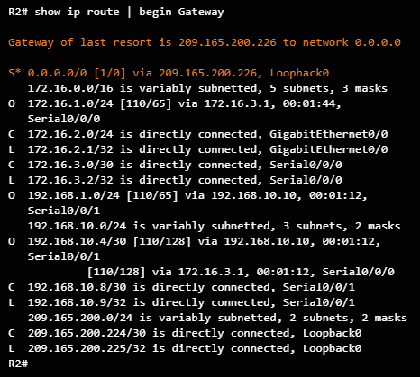
Advanced Single-Area OSPF Configurations Verifying the Propagated Default Route
Use the show ip route command to verify the default route settings..
Notes:
10.1 - Advanced Single-Area OSPF Configurations
10.1.2 – Default Route Propagation
10.1.2.2 – Verifying the Propagated IPv4 Default Route

Slide 29
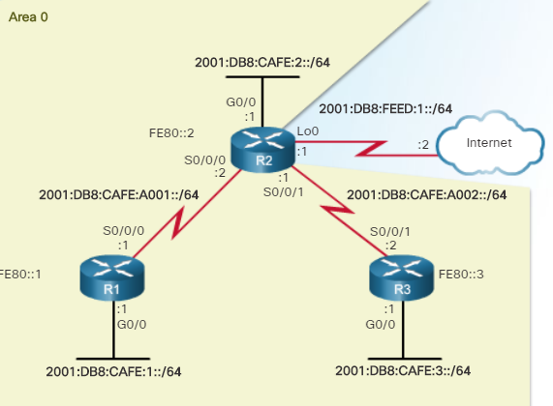
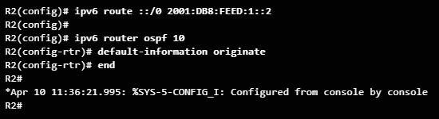
Advanced Single-Area OSPF Configurations Propagating a Default Static Route in OSPFv3
To propagate a default route, the edge router (R2) must be configured with:
A default static route using the ipv6 route ::/0 {ipv6-address | exit-intf} command.
The default-information originate router configuration mode command.
Notes:
10.1 - Advanced Single-Area OSPF Configurations
10.1.2 – Default Route Propagation
10.1.2.3 – Propagating a Default Static Route in OSPFv3

Slide 30
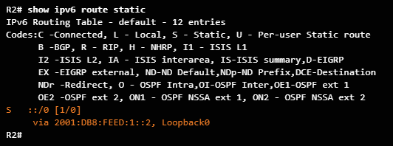
Advanced Single-Area OSPF Configurations Verifying the Propagated IPv6 Default Route
Verify the default static route setting on R2 using the show ipv6 route static command.
Notes:
10.1 - Advanced Single-Area OSPF Configurations
10.1.2 – Default Route Propagation
10.1.2.4 – Verifying the Propagated IPv6 Default Route

Slide 31
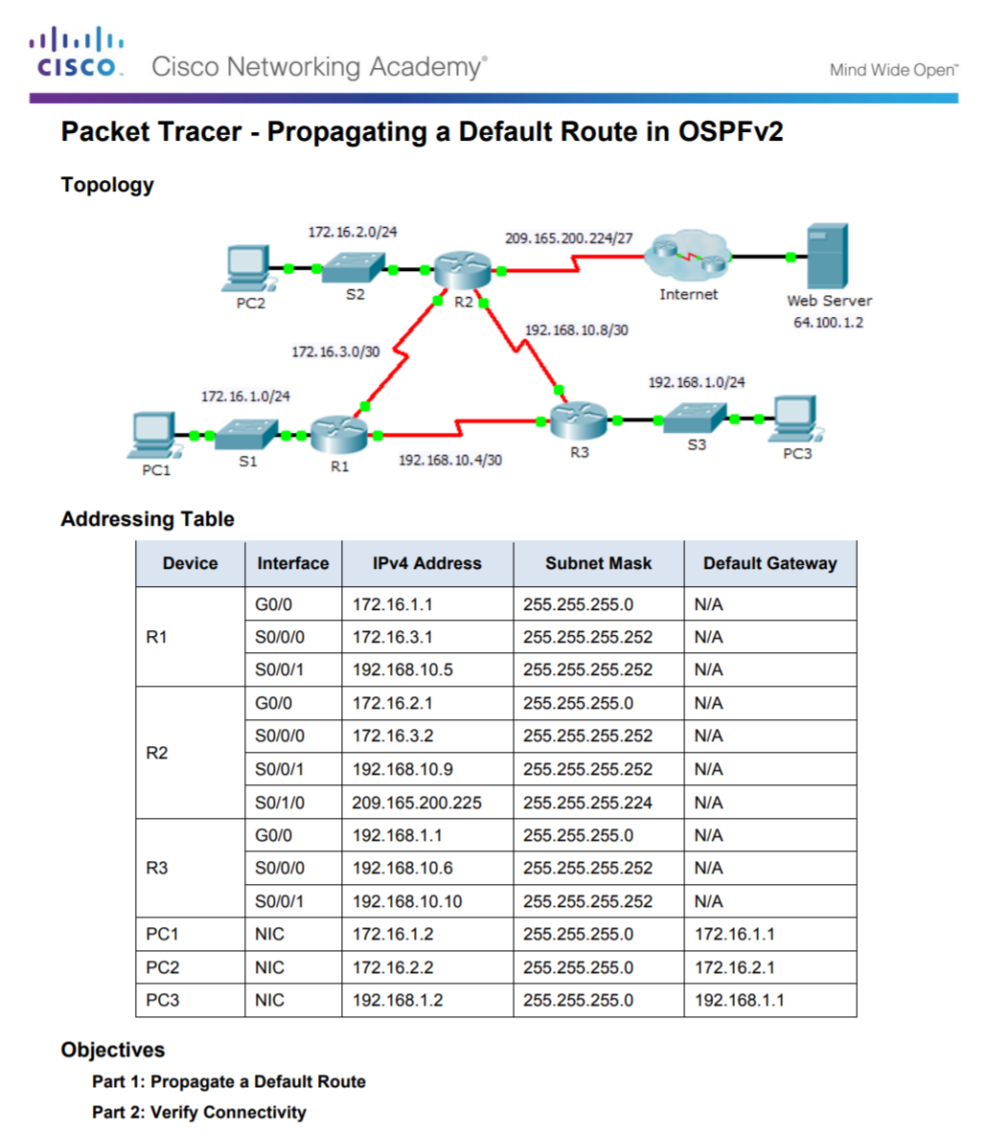
Advanced Single-Area OSPF Configurations Propagating a Default Route in OSPFv2
Notes:
10.1 - Advanced Single-Area OSPF Configurations
10.1.2 – Default Route Propagation
10.1.2.5 – Packet Tracer - Propagating a Default Route in OSPFv2

Slide 32
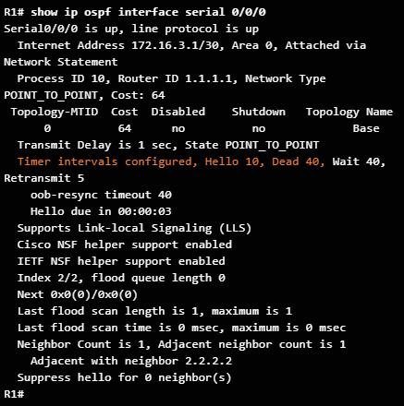
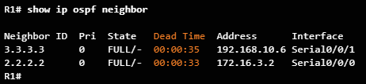
Advanced Single-Area OSPF Configurations OSPF Hello and Dead Intervals
The OSPF Hello and Dead intervals used between two adjacent peers must match or a neighbor adjacency does not occur.
The OSPF Hello and Dead intervals are configurable on a per-interface basis.
The Serial 0/0/0 Hello and Dead intervals are set to the default 10 seconds and 40 seconds respectively.
To verify the currently configured OSPFv2 interface intervals, use the show ip ospf interface command
Use the show ip ospf neighbor command to verify that a router is adjacent with other routers.
Notes:
10.1 - Advanced Single-Area OSPF Configurations
10.1.3 – Fine-tuning OSPF Interfaces
10.1.3.1 – OSPF Hello and Dead Intervals

Slide 33
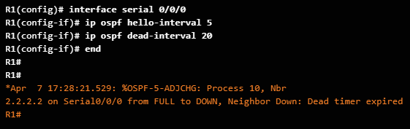
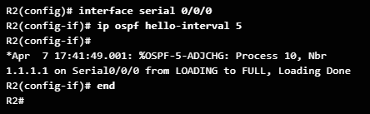
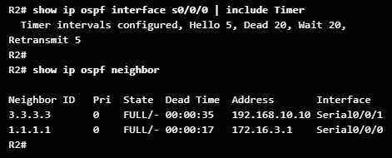
Advanced Single-Area OSPF Configurations Modifying OSPFv2 Intervals
OSPFv2 Hello and Dead intervals can be modified using the interface configuration mode commands:
ip ospf hello-interval seconds
ip ospf dead-interval seconds
Use the no ip ospf hello-interval and no ip ospf dead-interval interface configuration commands to reset the intervals to their default.
Notes:
10.1 - Advanced Single-Area OSPF Configurations
10.1.3 – Fine-tuning OSPF Interfaces
10.1.3.2 – Modifying OSPFv2 Intervals

Slide 34
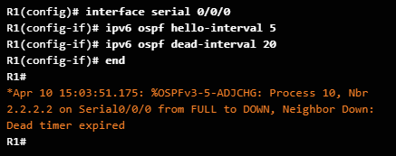
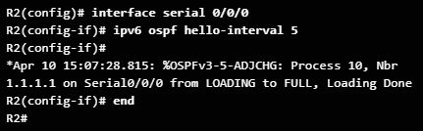
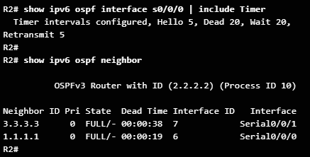
Advanced Single-Area OSPF Configurations Modifying OSPFv3 Intervals
OSPFv3 Hello and Dead intervals can be modified using the interface configuration mode commands:
ipv6 ospf hello-interval seconds
ipv6 ospf dead-interval seconds
Use the no ipv6 ospf hello-interval and no ipv6 ospf dead-interval interface configuration commands to reset the intervals to their default.
Notes:
10.1 - Advanced Single-Area OSPF Configurations
10.1.3 – Fine-tuning OSPF Interfaces
10.1.3.3 – Modifying OSPFv3 Intervals

Slide 35
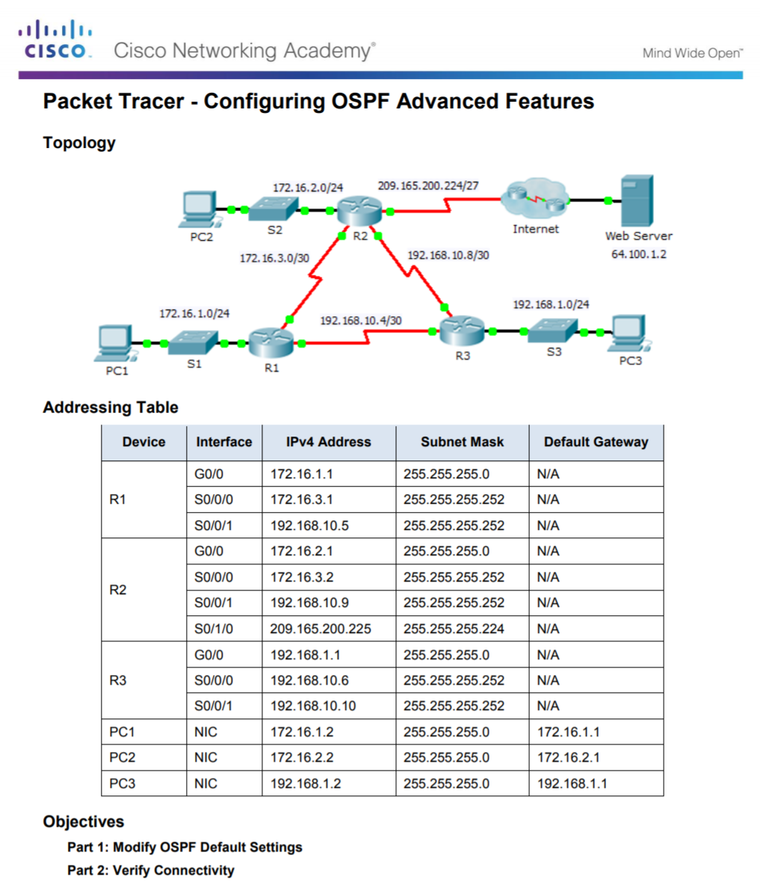
Advanced Single-Area OSPF Configurations Configuring OSPFv2 Advanced Features
Notes:
10.1 - Advanced Single-Area OSPF Configurations
10.1.3 – Fine-tuning OSPF Interfaces
10.1.3.4 – Packet Tracer - Configuring OSPF Advanced Features

Slide 36
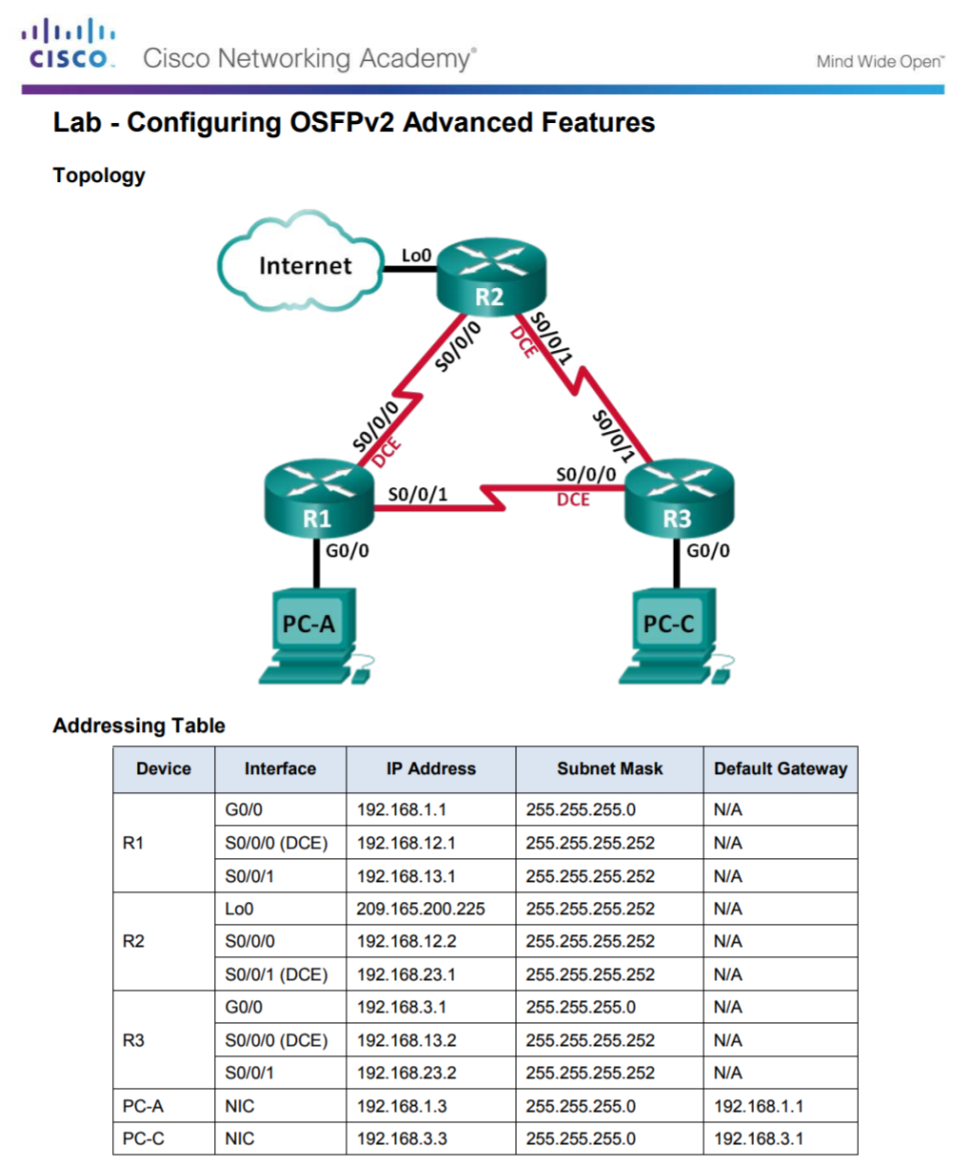
Advanced Single-Area OSPF Configurations Configuring OSPFv2 Advanced Features
Notes:
10.1 - Advanced Single-Area OSPF Configurations
10.1.3 – Fine-tuning OSPF Interfaces
10.1.3.5 – Lab - Configuring OSFPv2 Advanced Features

Slide 37
10.2 Troubleshooting Single-Area OSPF Implementations
Notes:
10 – OSPF Tuning and Troubleshooting
10.2 – Troubleshooting Single-Area OSPF Implementations

Slide 38
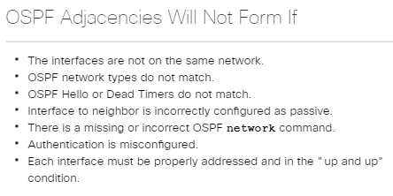
Troubleshooting Single-Area OSPF Implementations Components of Troubleshooting Single-Area OSPF
OSPF is a popular routing protocol in large enterprise networks.
Troubleshooting problems related to the exchange of routing information is one of the most essential skills for a network administrator.
Notes:
10.2 - Troubleshooting Single-Area OSPF Implementations
10.2.1 – Components of Troubleshooting Single-Area OSPF
10.2.1.1 – Overview

Slide 39
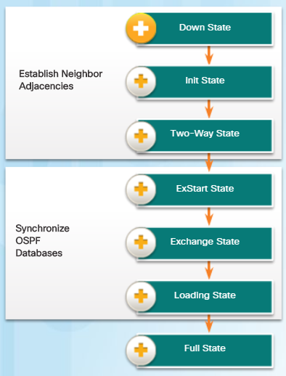
Troubleshooting Single-Area OSPF Implementations OSPF States
To troubleshoot OSPF, it is important to understand how OSPF routers traverse different OSPF states when adjacencies are being established.
When troubleshooting OSPF neighbors, be aware that the FULL or 2WAY states are normal.
All other states are transitory and the router should not remain in those states for extended periods of time.
Notes:
10.2 - Troubleshooting Single-Area OSPF Implementations
10.2.1 – Components of Troubleshooting Single-Area OSPF
10.2.1.2 – OSPF States

Slide 40
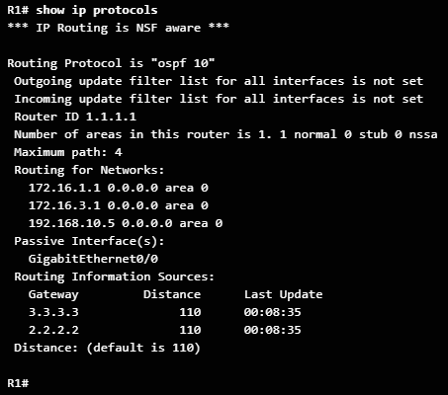
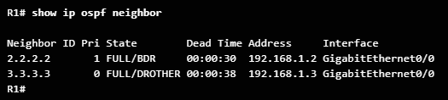
Troubleshooting Single-Area OSPF Implementations OSPF Troubleshooting Commands
Common OSPFv2 troubleshooting commands include:
show ip protocols - Used to verify vital OSPFv2 configuration information.
show ip ospf neighbor - Used to verify that the router has formed an OSPFv2 adjacency with its neighboring routers.
show ip ospf interface - Used to display the OSPFv2 parameters configured on an interface.
show ip ospf - Used to examine the OSPFv2 process ID and router ID.
show ip route ospf - Used to display only the OSPFv2 learned routes in the IPv4 routing table. T
clear ip ospf [process-id] process - Used to reset the OSPFv2 neighbor adjacencies
Note: For the equivalent OSPFv3 command, simply substitute ip with ipv6.
Notes:
10.2 - Troubleshooting Single-Area OSPF Implementations
10.2.1 – Components of Troubleshooting Single-Area OSPF
10.2.1.3 – OSPF Troubleshooting Commands

Slide 41
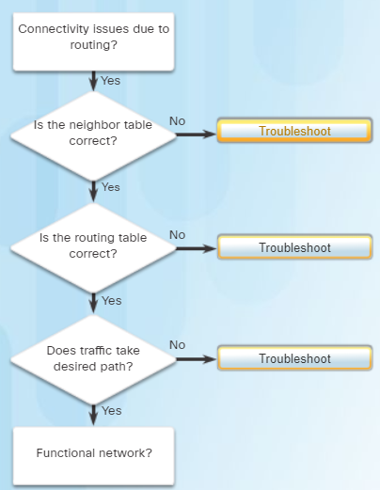
Troubleshooting Single-Area OSPF Implementations Components of Troubleshooting OSPF
OSPF problems usually relate to:
Neighbor adjacencies
Missing routes
Path selection
Use:
show ip ospf neighbor
show ip interface brief
show ip ospf interface
Use:
show ip protocols
show ip route ospf
Use:
show ip route ospf
show ip ospf interface
Note: For the equivalent OSPFv3 command, simply substitute ip with ipv6.
Notes:
10.2 - Troubleshooting Single-Area OSPF Implementations
10.2.1 – Components of Troubleshooting Single-Area OSPF
10.2.1.4 – Components of Troubleshooting OSPF

Slide 42
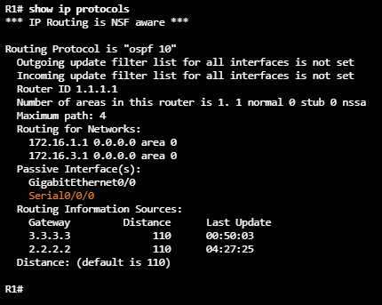
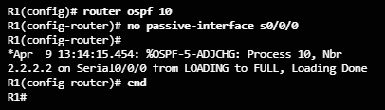
Troubleshooting Single-Area OSPF Implementations Troubleshooting Neighbor Issues
When troubleshooting neighbor issues:
Verify the routing table using the show ip route ospf command.
Verify that interfaces are active using the show ip interface brief command.
Verify active OSPF interfaces using the show ip ospf interface command.
Verify the OSPFv2 settings using the show ip protocols command.
Recall that the passive-interface command stops both outgoing and incoming routing updates and for that reason, routers will not become neighbors.
Notes:
10.2 - Troubleshooting Single-Area OSPF Implementations
10.2.2 –Troubleshooting Single-Area OSPFv2 Routing Issues
10.2.2.1 – Troubleshooting Neighbor Issues

Slide 43
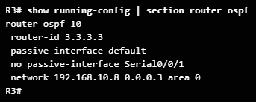
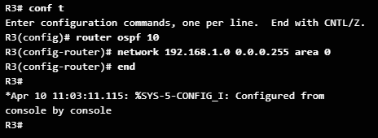
Troubleshooting Single-Area OSPF Implementations Troubleshooting OSPFv2 Routing Table Issues
When troubleshooting routing table issues:
Verify the routing table using the show ip route ospf command.
Verify the OSPFv2 settings using the show ip protocols command.
Verify the OSPF configuration using the show running-config | section router ospf command.
Notes:
10.2 - Troubleshooting Single-Area OSPF Implementations
10.2.2 –Troubleshooting Single-Area OSPFv2 Routing Issues
10.2.2.2 – Troubleshooting OSPFv2 Routing Table Issues

Slide 44
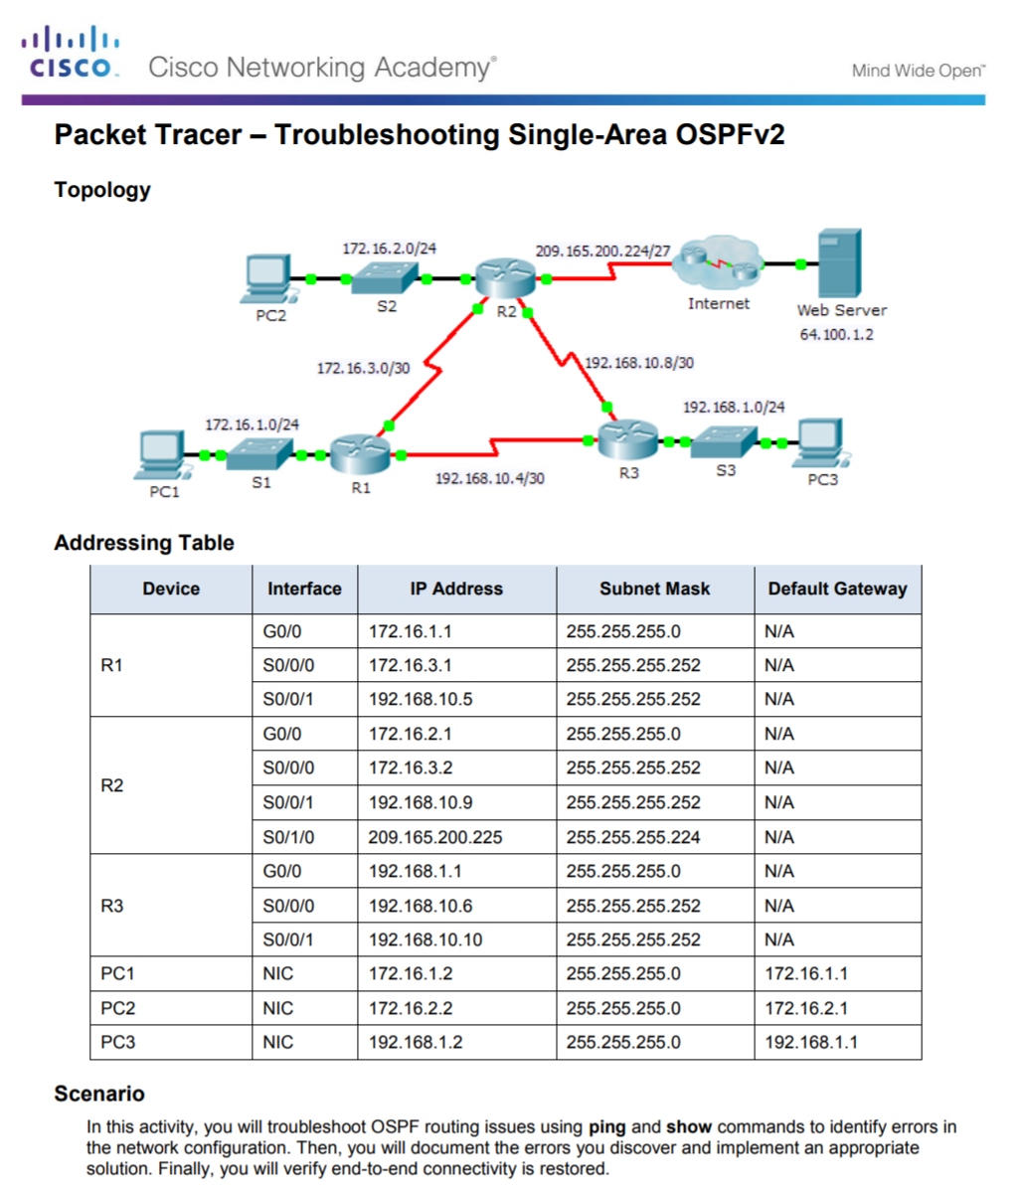
Troubleshooting Single-Area OSPF Implementations Troubleshooting Single-Area OSPFv2
Notes:
10.2 - Troubleshooting Single-Area OSPF Implementations
10.2.2 –Troubleshooting Single-Area OSPFv2 Routing Issues
10.2.2.3 – Packet Tracer - Troubleshooting Single-Area OSPFv2

Slide 45
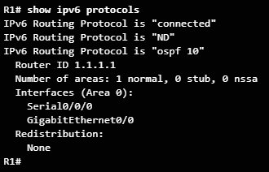

Troubleshooting Single-Area OSPF Implementations OSPFv3 Troubleshooting Commands
Common OSPFv3 troubleshooting commands include:
show ipv6 protocols - Used to verify vital OSPFv3 configuration information.
show ipv6 ospf neighbor - Used to verify that the router has formed an OSPFv3 adjacency with its neighboring routers.
show ipv6 ospf interface - Used to display the OSPFv3 parameters configured on an interface.
show ipv6 ospf - Used to examine the OSPFv3 process ID and router ID.
show ipv6 route ospf - Used to display only the OSPFv3 learned routes in the IPv4 routing table. T
clear ipv6 ospf [process-id] process - Used to reset the OSPFv3 neighbor adjacencies
.
Notes:
10.2 - Troubleshooting Single-Area OSPF Implementations
10.2.3 –Troubleshooting Single-Area OSPFv3 Routing Issues
10.2.3.1 – OSPFv3 Troubleshooting Commands

Slide 46
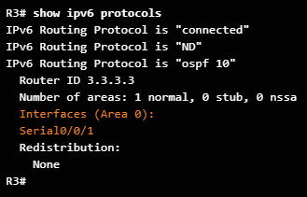
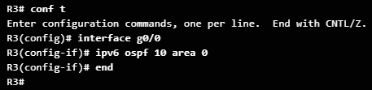
Troubleshooting Single-Area OSPF Implementations Troubleshooting OSPFv3
In this example, R1 is not receiving the R3 LAN OSPFv3 route (2001:DB8:CAFE:3::/64).
Verifying the R3 routing protocol settings reveals that R3 is not enabled on the G0/0 R3 interface.
Enable OSPFv3 on the R3 Gigabit Ethernet 0/0 interface.
The R3 LAN is now in the routing table of R1.
Notes:
10.2 - Troubleshooting Single-Area OSPF Implementations
10.2.3 –Troubleshooting Single-Area OSPFv3 Routing Issues
10.2.3.2 – Troubleshooting OSPFv3

Slide 47
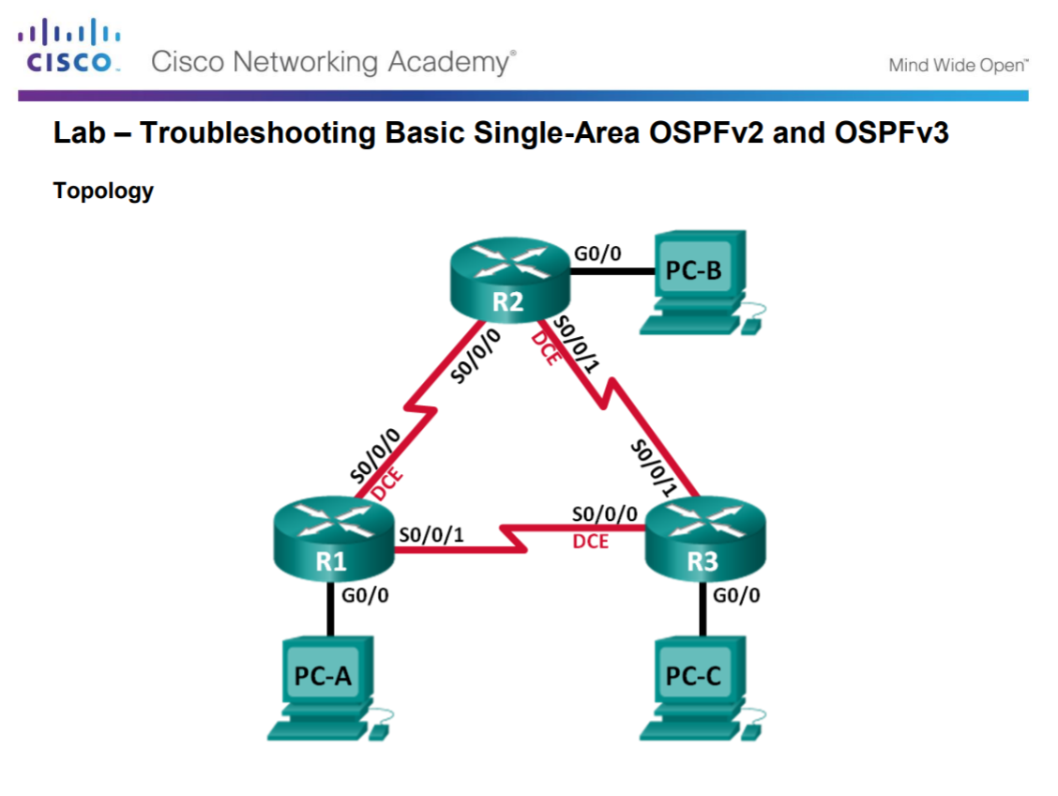
Troubleshooting Single-Area OSPF Implementations Troubleshooting Basic Single-Area OSPFv2 and OSPFv3
Notes:
10.2 - Troubleshooting Single-Area OSPF Implementations
10.2.3 –Troubleshooting Single-Area OSPFv3 Routing Issues
10.2.3.3 – Lab - Troubleshooting Basic Single-Area OSPFv2 and OSPFv3

Slide 48
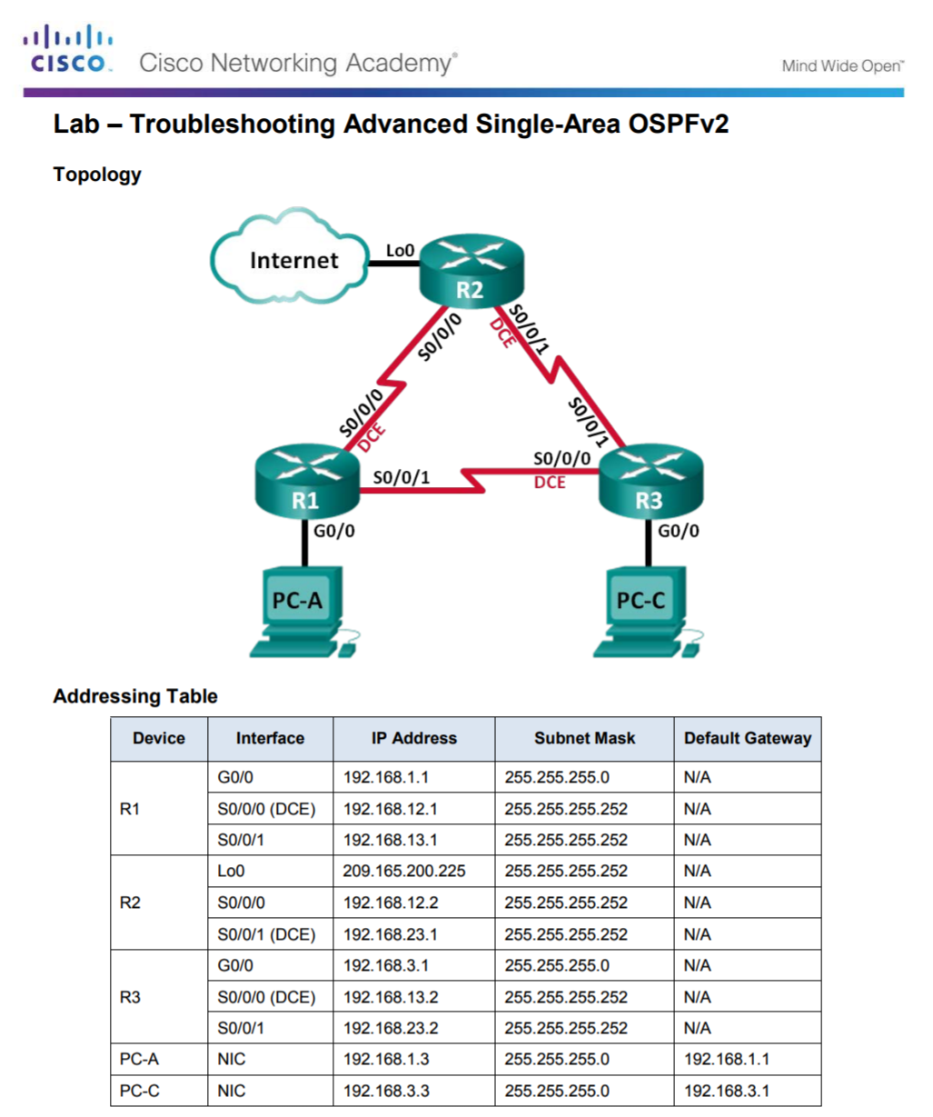
Troubleshooting Single-Area OSPF Implementations Troubleshooting Advanced Single-Area OSPFv2
Notes:
10.2 - Troubleshooting Single-Area OSPF Implementations
10.2.3 –Troubleshooting Single-Area OSPFv3 Routing Issues
10.2.3.4 – Lab - Troubleshooting Advanced Single-Area OSPFv2

Slide 49
Troubleshooting Single-Area OSPF Implementations Multiarea OSPF Troubleshooting Skills
Before you can begin to diagnose and resolve problems related to a multiarea OSPF implementation, you must be able to do the following:
Understand the processes OSPF uses to distribute, store, and select routing information.
Understand how OSPF information flows within and between areas.
Use Cisco IOS commands to gather and interpret the information necessary to troubleshoot OSPF operation.
Notes:
10.2 - Troubleshooting Single-Area OSPF Implementations
10.2.4 –Troubleshooting Multi-Area OSPFv2 and OSPFv3
10.2.4.1 – Multiarea OSPF Troubleshooting Skills

Slide 50
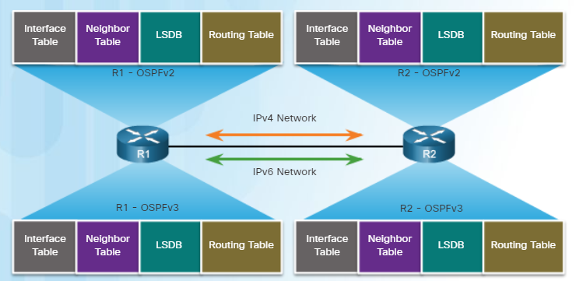
Troubleshooting Single-Area OSPF Implementations Multiarea OSPF Troubleshooting Data Structures
OSPF stores routing information in four main data structures:
OSPF Data Structures | Description
Interface table | Includes a list of all active OSPF interfaces. Type 1 LSAs include the subnets associated with each active interface.
Neighbor table | Used to manage neighbor adjacencies through hello timers and dead timers. Neighbor entries are added and refreshed when a hello is received. Neighbors are removed when dead timer expires.
Link-state database (LSDB) | This is the primary data structure used by OSPF to store network topology information. It includes full topological information about each area that the OSPF router is connected to and any paths that are available to reach other networks.
Routing table | After the SPF algorithm is calculated, the best routes are offered to the routing table
Notes:
10.2 - Troubleshooting Single-Area OSPF Implementations
10.2.4 –Troubleshooting Multi-Area OSPFv2 and OSPFv3
10.2.4.2 – Multiarea OSPF Troubleshooting Data Structures

Slide 51
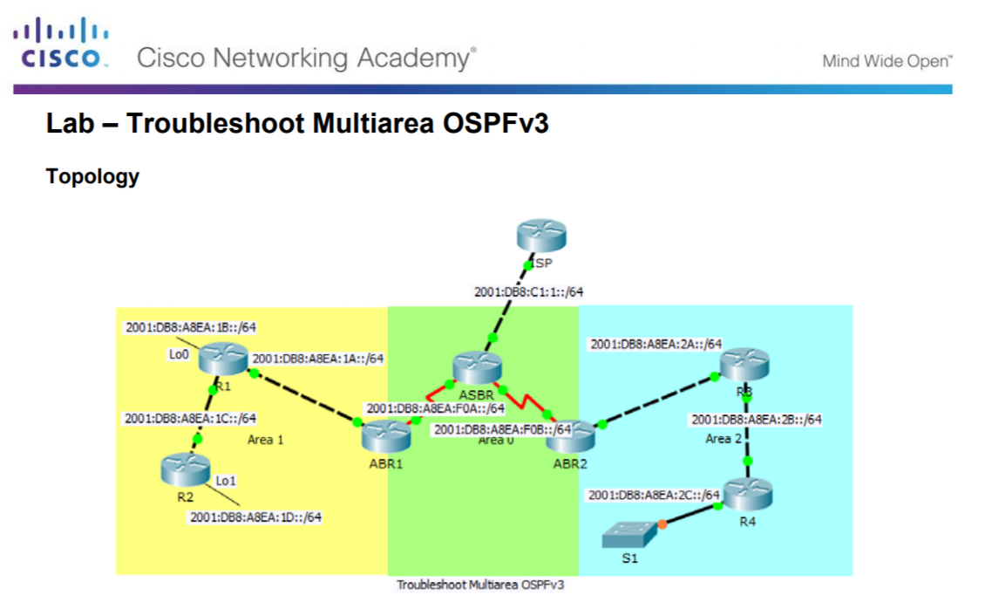
Troubleshooting Single-Area OSPF Implementations Troubleshooting Multiarea OSPFv2
Notes:
10.2 - Troubleshooting Single-Area OSPF Implementations
10.2.4 –Troubleshooting Multi-Area OSPFv2 and OSPFv3
10.2.4.3 – Packet Tracer – Troubleshooting Multiarea OSPFv2

Slide 52
Troubleshooting Single-Area OSPF Implementations Troubleshooting Multiarea OSPFv3
Notes:
10.2 - Troubleshooting Single-Area OSPF Implementations
10.2.4 –Troubleshooting Multi-Area OSPFv2 and OSPFv3
10.2.4.4 – Packet Tracer – Troubleshooting Multiarea OSPFv3

Slide 53
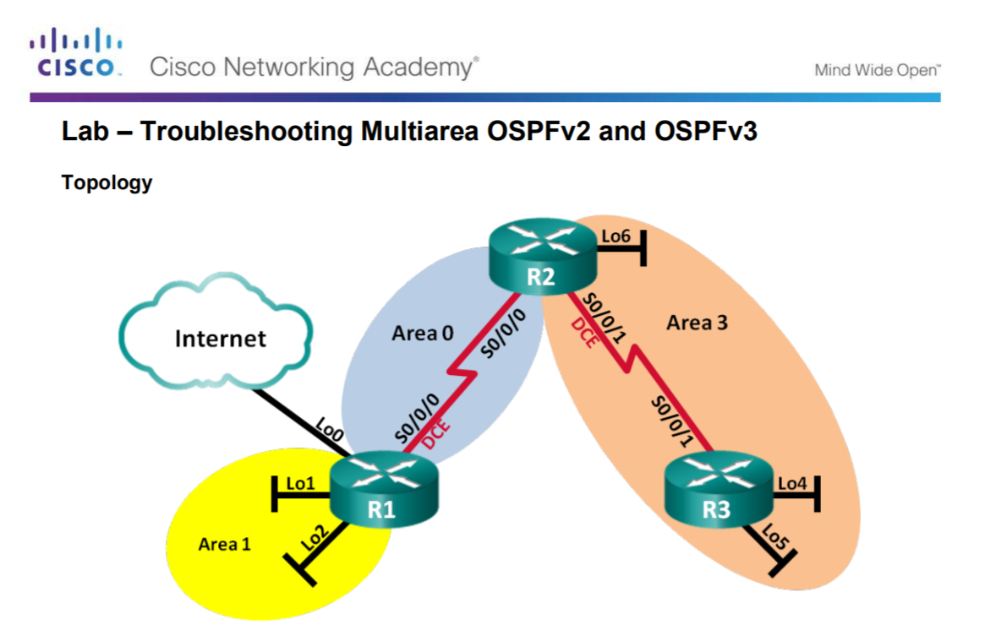
Troubleshooting Single-Area OSPF Implementations Troubleshooting Multiarea OSPFv2 and OSPFv3
Notes:
10.2 - Troubleshooting Single-Area OSPF Implementations
10.2.4 –Troubleshooting Multi-Area OSPFv2 and OSPFv3
10.2.4.5 – Lab - Troubleshooting Multiarea OSPFv2 and OSPFv3

Slide 54
10.3 Chapter Summary
Notes:
10 – OSPF Tuning and Troubleshooting
10.3 – Summary

Slide 55
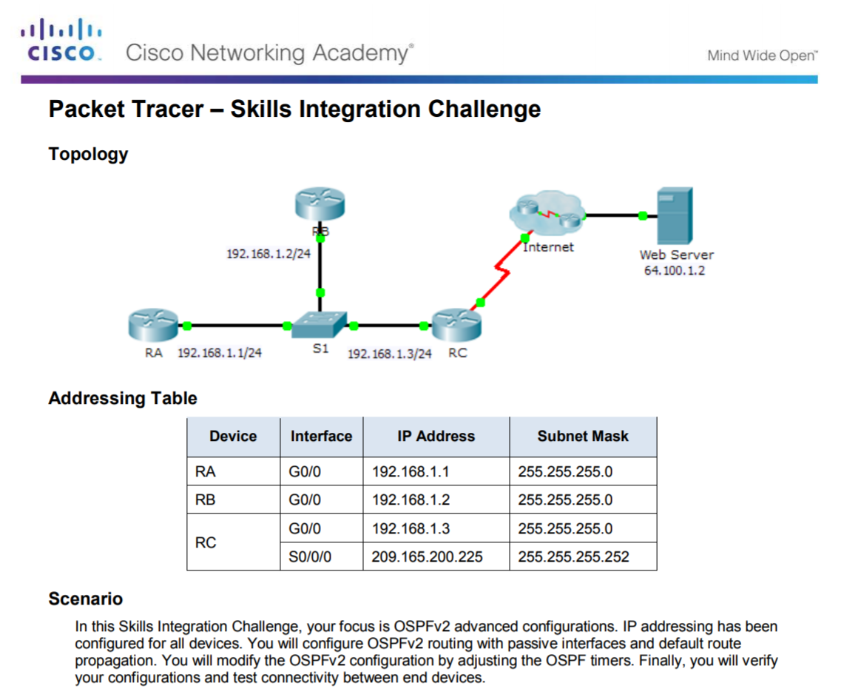
Conclusion Packet Tracer - Skills Integration Challenge
Notes:
10.3 – Summary
10.3.1 – Conclusion
10.3.1.2 – Packet Tracer - Skills Integration Challenge

Slide 56
Conclusion Chapter 10: OSPF Tuning and Troubleshooting
OSPF defines five network types: point-to-point, broadcast multiaccess, nonbroadcast multiaccess, point-to-multipoint, and virtual links.
Multiaccess networks can create two challenges for OSPF regarding the flooding of LSAs: creation of multiple adjacencies and extensive flooding of LSAs. The solution to managing the number of adjacencies and the flooding of LSAs on a multiaccess network is the DR and BDR. If the DR stops producing Hellos, the BDR promotes itself and assumes the role of DR.
The routers in the network elect the router with the highest interface priority as DR. The router with the second highest interface priority is elected the BDR. The higher the priority, the likelier the router will be selected as the DR. If set to 0, the router is not capable of becoming the DR. The default priority of multiaccess broadcast interfaces is 1. Therefore, unless otherwise configured, all routers have an equal priority value and must rely on another tie breaking method during the DR/BDR election. If the interface priorities are equal, then the router with the highest router ID is elected the DR. The router with the second highest router ID is the BDR. The addition of a new router does not initiate a new election process.
Notes:
10.3 – Summary
10.3.1 – Conclusion
10.3.1.3 – Chapter 10: OSPF Tuning and Troubleshooting

Slide 57
Conclusion Chapter 10: OSPF Tuning and Troubleshooting (Cont.)
To propagate a default route in OSPF, the router must be configured with a default static route and the default-information originate command must be added to the configuration. Verify routes with the show ip route or show ipv6 route command.
To assist OSPF in making the correct path determination, the reference bandwidth must be changed to a higher value to accommodate networks with links faster than 100 Mbps. To adjust the reference bandwidth, use the auto-cost reference-bandwidth Mbps router configuration mode command. To adjust the interface bandwidth, use the bandwidth kilobits interface configuration mode command. The cost can be manually configured on an interface using the ip ospf cost value interface configuration mode command.
The OSPF Hello and Dead intervals must match or a neighbor adjacency does not occur. To modify these intervals, use the following interface commands:
ip ospf hello-interval seconds
ip ospf dead-interval seconds
ipv6 ospf hello-interval seconds
ipv6 ospf dead-interval seconds
Notes:
10.3 – Summary
10.3.1 – Conclusion
10.3.1.3 – Chapter 10: OSPF Tuning and Troubleshooting

Slide 58
Conclusion Chapter 10: OSPF Tuning and Troubleshooting (Cont.)
When troubleshooting OSPF neighbors, be aware that the FULL or 2WAY states are normal. The following commands summarize OSPFv2 troubleshooting:
show ip protocols
show ip ospf neighbor
show ip ospf interface
show ip ospf
show ip route ospf
clear ip ospf [process-id] process
Troubleshooting OSPFv3 is similar to OSPFv2. The following commands are the equivalent commands used with OSPFv3: show ipv6 protocols, show ipv6 ospf neighbor, show ipv6 ospf interface, show ipv6 ospf, show ipv6 route ospf, and clear ipv6 ospf [process-id] process.
Notes:
10.3 – Summary
10.3.1 – Conclusion
10.3.1.3 – Chapter 10: OSPF Tuning and Troubleshooting

Slide 59
New Terms and Commands
Broadcast multiaccess Point-to-multipoint Virtual links OSPF Hello and Dead intervals
Notes:
10.3 – Summary
10.3.1 – Conclusion
10.3.1.3 – Chapter 10: OSPF Tuning and Troubleshooting

